Slide 1
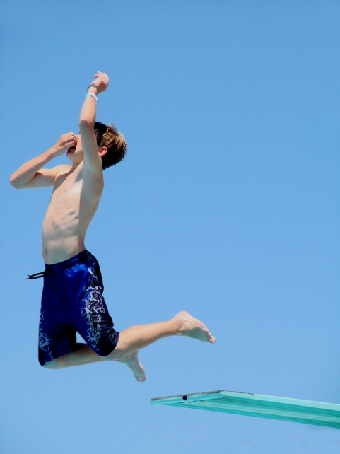
Physical Development
Understanding Physical Development in Young Children

Slide 2
PHYSICAL DEVELOPMENT
Definition
  Growth
  Movement & Mobility
    The development of:
      Fine motor and gross motor skills
      Whole body movement

Slide 3
PHYSICAL DEVELOPMENT
Provides children with the abilities they need to explore and interact with the world around them
Begins as muscles gain strength
  The development of muscular control is the first step in physical development

Slide 4

Physical Development
Factors that affect physical development:
  Heredity (Nature)
  Environment (Nurture)
    Proper Nutrition
    Appropriate Toys and Activities

Slide 5
Physical Development
Patterns of Physical Development
  GROWTH
    Head to foot
    Near to far
  MOVEMENT & MOBILITY
    Simple to complex
Notes:
Large to small muscle: Large muscles develop in the neck, trunk, arms, and legs before the small muscles in the fingers, hands, wrists, and eyes develop. Children can walk before they can write or scribble.
Head to toe: Babies can hold their heads long before they can walk
Inside to outside: Muscles develop from the center of the body first and then toward the outside of the body. Muscles around the trunk of the body develop earlier and are stronger than muscles in the hands, feet, etc.

Slide 6
Physical Development- GROWTH
Weight
Height
Proportion
Sight
Hearing
Smell and Taste
Voice
Teeth

Slide 7
Physical Development- GROWTH
Four physical growth cycles
  Two of slow growth
  Two of rapid growth
1: Rapid Physical Growth
  Conception to 6 months of age
2: Slow Physical Growth
  Toddler and preschool periods
3: Rapid Physical Growth
  Preadolescence and adolescence (Puberty)
4: Slow Physical Growth
  After puberty until adult growth is achieved

Slide 8
Physical Development- MOVEMENT & MOBILITY
Motor Development Definition
  Growth in the ability of children to use their bodies and physical skills in a process in which children acquire movement patterns and skills
  Influences:
    Genetics, size at birth, body build and composition, nutrition, rearing and birth order, social class, temperament, ethnicity, and culture

Slide 9
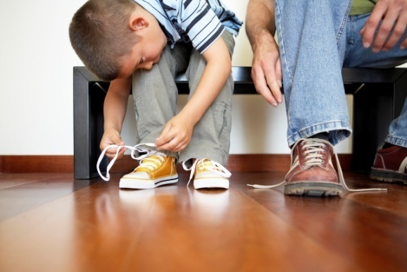
Physical Development- MOVEMENT & MOBILITY
Motor Development
      Critical time for motor development is between 1 year to 5 years of age
  Gross Motor Development
    Large-muscle groups
      Legs (running) and arms (throwing)
  Fine Motor Development
    Small-muscle groups
      Smiling, picks up a fork, tying a shoe

Slide 10
Physical Development- MOVEMENT & MOBILITY
Types of Movement and Their Benefits for Children
  Locomotor Movement
    Movement of the body from place to place
      Crawling, walking, hopping, jumping, skipping, running
  Nonlocomotor Movement
    Movement of the body while staying in one place
      Pulling, twisting, wiggling, sitting, rising
  Manipulative Movement
    Movement that involves controlled use of the hands and feet
      Grasping, opening and closing hands, waving, throwing and catching

Slide 11
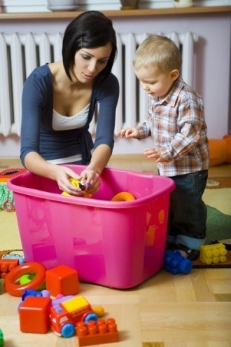
Physical Development
Infants (up to 1st birthday)
  Size and Shape
    Weight: Changes Daily
    Length: Changes Rapidly
  Reflexes
    Rooting (Turn head toward anything that brushes their faces)
    Startle Reflex
    Grasp
    Stepping or Walking
  Motor Sequence
    Order in which a child is able to perform new movements
    Each movement builds upon previous abilities
      Example: head and trunk control

Slide 12
Physical Development
Toddlers (1-3 years)
  By the age of two-and-a-half, the average child has reached half of his or her adult height
  Arms and legs lengthen
  Baby fat begins to disappear
  Redistribute weight to improve balance and posture
  Ability to manipulate objects with hands
  Teeth come in

Slide 13
Physical Development
Preschoolers (3-5 years)
  Grow faster in height than weight
    Lanky appearance
  Upper jaw widens for permanent teeth
  Ability to move more freely
    Run, jump, ride a tricycle, and kick a ball
  Gain ability to manipulate smaller objects with hands
    Tie shoelaces, button buttons

Slide 14
Physical Development
From muscles to motor skills, the unfolding picture of a child’s physical growth is an exciting experience to observe
Parents and caregivers should pay attention to their child’s physical growth and give loving support as their children develop these skills

Slide 15
Physical Development
Promote:
  Good Eating Habits
  Physical Activity
  Motor Development
  Good Hygiene
    Dental Care, Bathing, Toileting
  Good Sleep Habits

